Slide 1

CIS8045 2023 Spring
Airlines Sentiment Analysis
Ashutosh Misra
Jennifer An
Nikhil Shenoy
Ning Chu
Sohaib Ahmed

Slide 2
Contents
1
Introduction
5
Sentiment Analysis Models
2
Data Source
6
Model Evaluation
3
7
Exploratory Data Analysis
Conclusion
4
Text Preprocessing
8
Future Work

Slide 3
01
Introduction

Slide 4




Problem Description
Products & services
Social Media
Marketing strategies
Management

Slide 5
Solution
Identifies and retrieves relevant sets of text data
Uses analytical models to identified attributes
Runs algorithms to summarize/ categorize/organize the data
Applied findings for applications
Notes:
Solution:
1. Identifies and retrieves relevant sets of text data to analyze
2. Runs algorithms to categorize, summarize and organized the data
3. Uses analytical models to ID concepts and patterns and other attributes
4. Applied the findings for applications such as sentiment analysis

Slide 6
02
Data Source

Slide 7
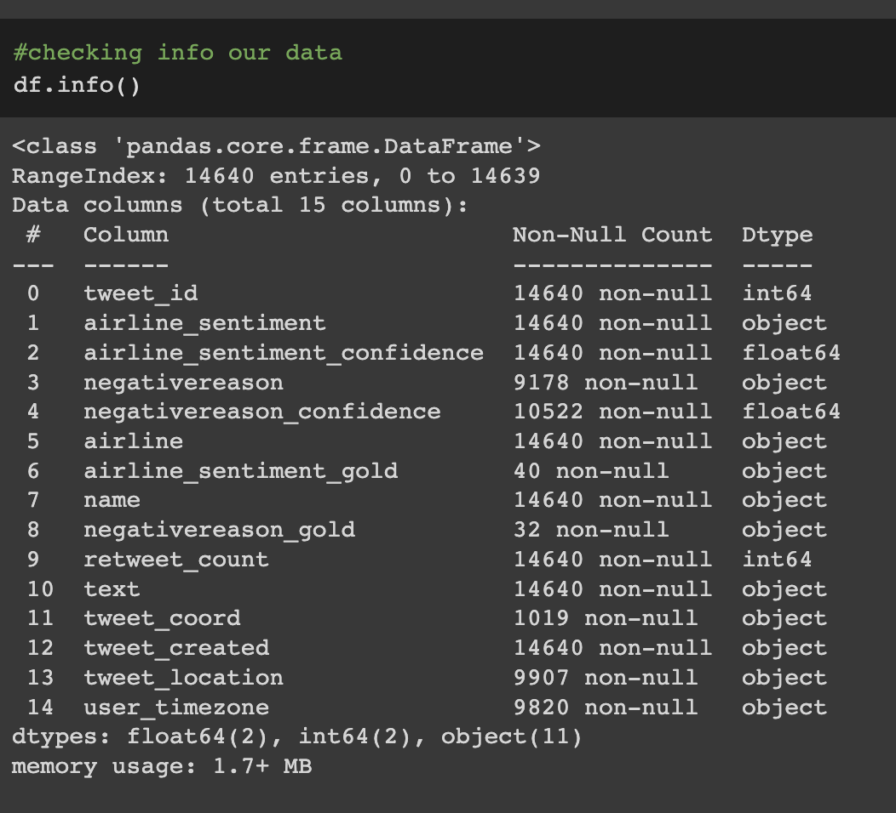
Data Description
Data Source: Kaggle (link)
Total Number of Data: 14641
Columns: 15
Data types: Numeric (4) String (11)
The dataset contains customer reviews from twitter about airline passengers, including additional information about each tweet, time zone, location, etc.

Slide 8
03
Data Exploring

Slide 9
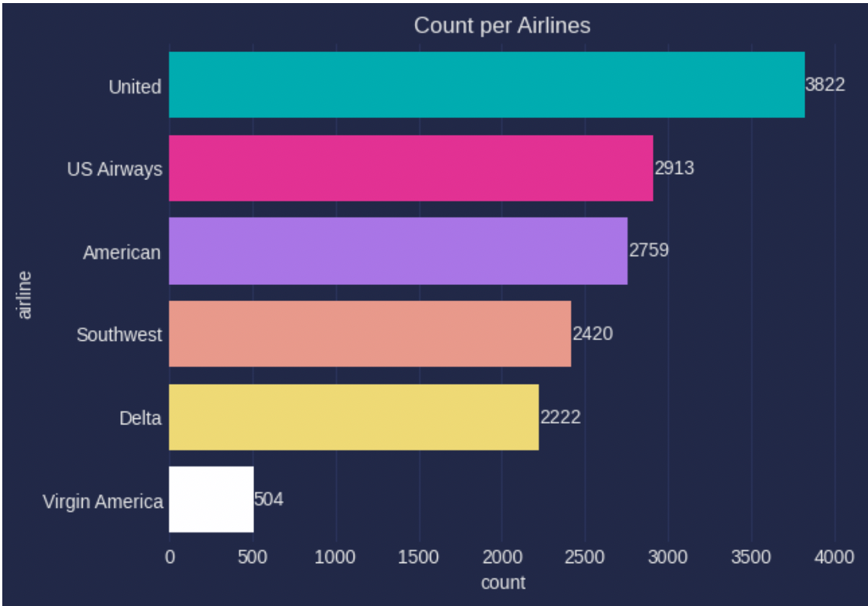
Data Exploring
1.Total Tweet Count Per Airline
United Airlines has the highest number of tweets, followed by US Airways and American Airlines.
The lowest number of tweets belongs to Virgin America.
编辑标题
单击编辑标题
汇报：张三

Slide 10
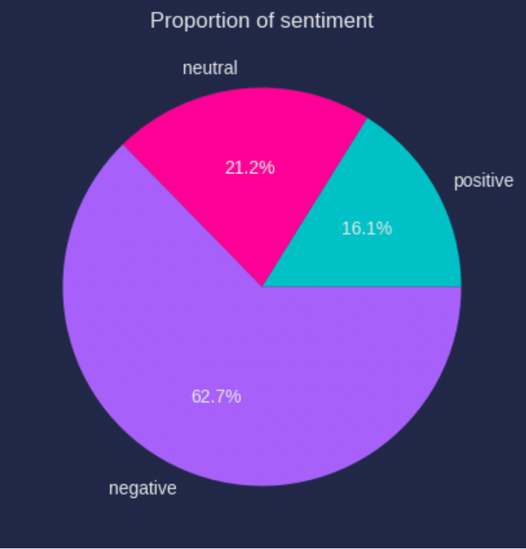
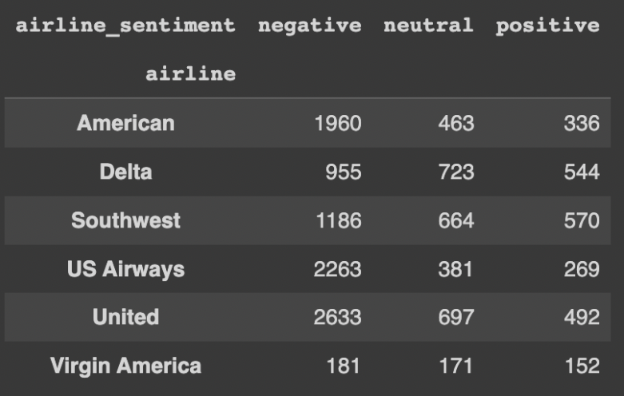
Data Visualization
2. Proportion of Sentiment
编辑标题
单击编辑标题
汇报：张三
United has the highest number of negative tweets
United has the highest number of neutral tweets
Southwest has the highest number of positive tweets

Slide 11
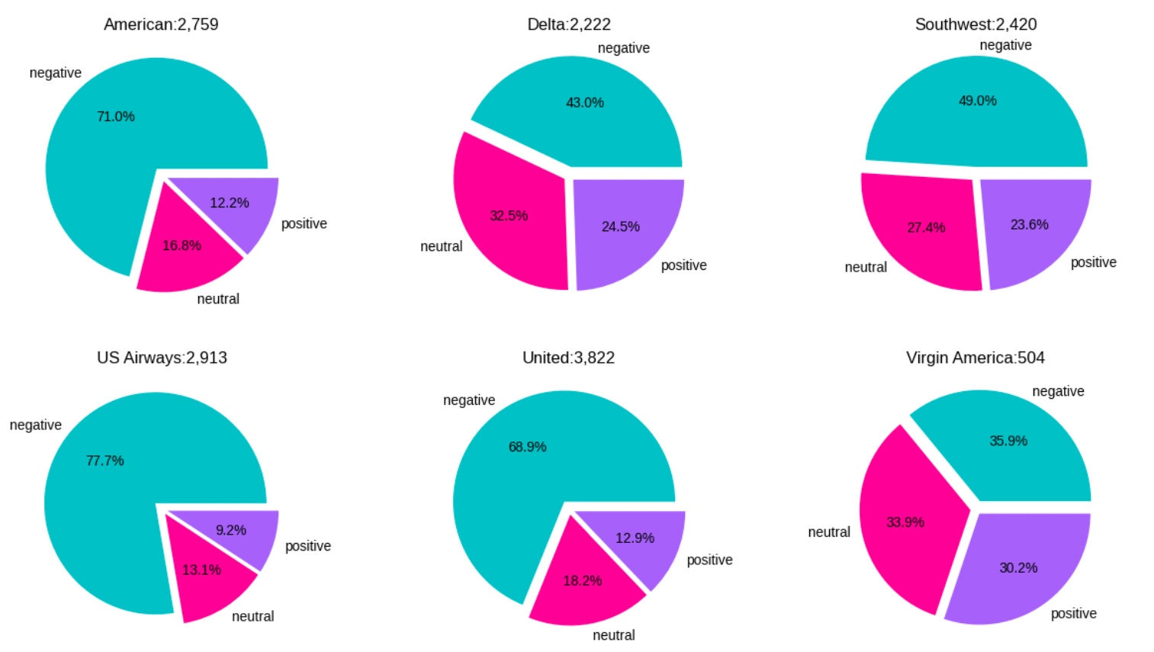
Data Visualization
3. Proportion of Sentiment in each airlines
编辑标题
单击编辑标题
汇报：张三

Slide 12
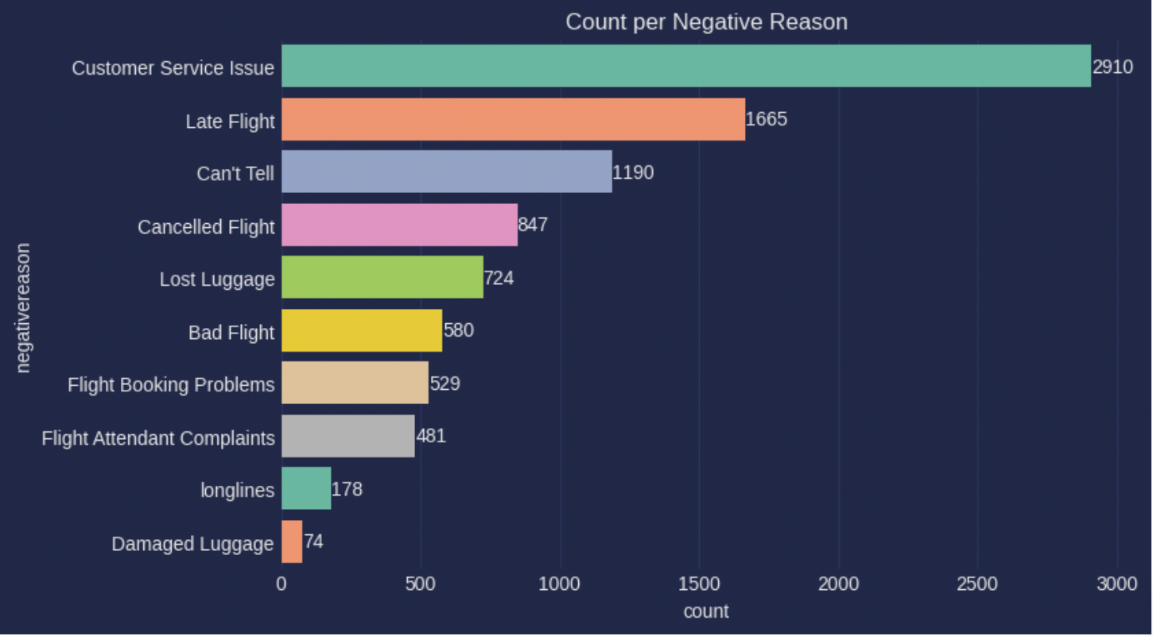
Data Visualization
4. Reasons Of Negative Tweets
编辑标题
单击编辑标题
汇报：张三

Slide 13
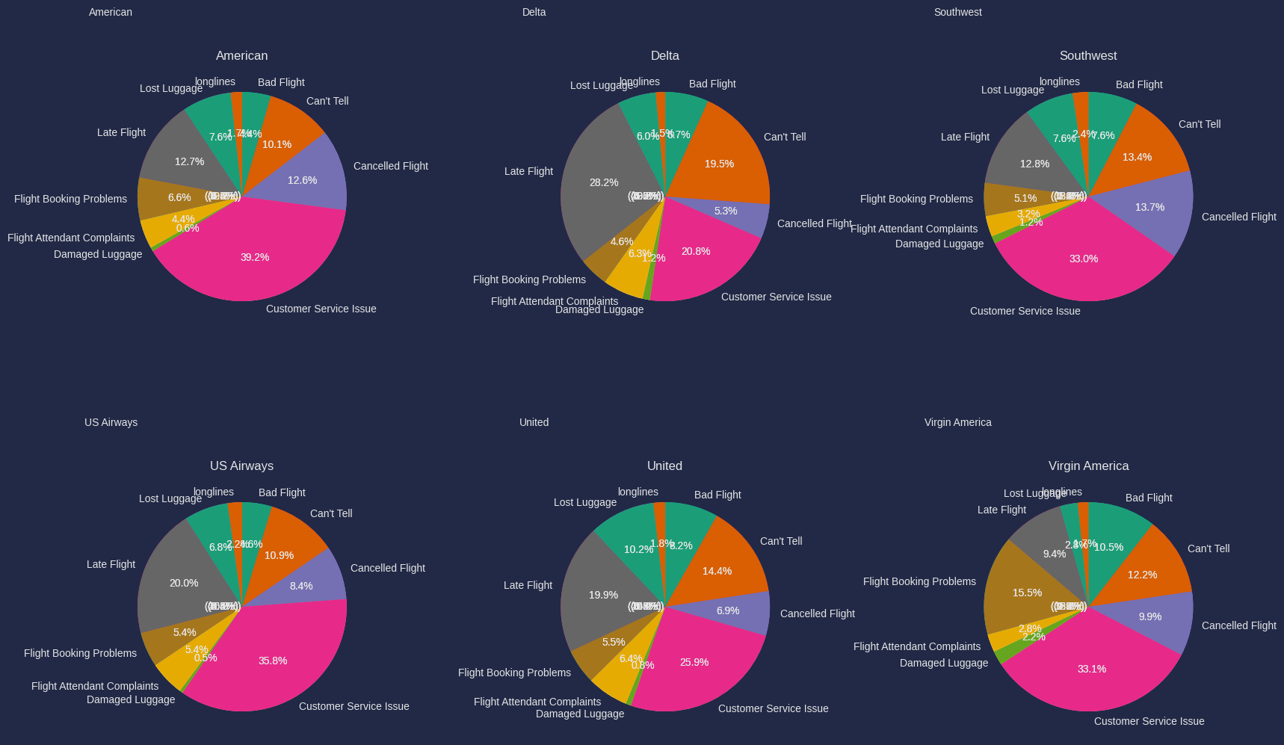
Data Visualization
5. Proportion of Negative Reasons in each airline
编辑标题
单击编辑标题
汇报：张三

Slide 14
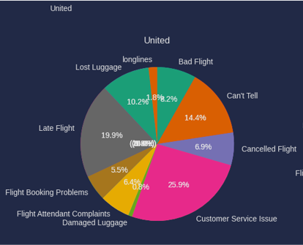
Data Visualization
5. Proportion of Negative Reasons in Top3 worse Airline
编辑标题
单击编辑标题
汇报：张三
US Airways
United
American

Slide 15
Data Visualization
5. Proportion of Negative Reasons in Virgin America
编辑标题
单击编辑标题
汇报：张三

Slide 16
Data Visualization
5. Proportion of Negative Reasons in Delta & Southwest
编辑标题
单击编辑标题
汇报：张三

Slide 17
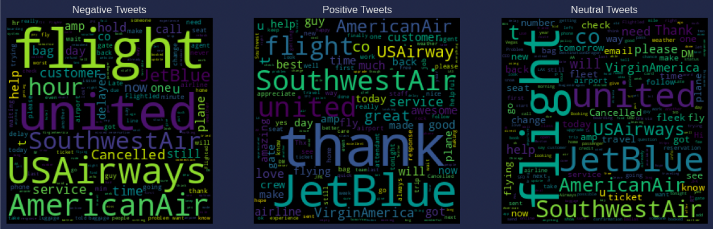
Data Visualization
6. Word Cloud about sentiment before text processing
编辑标题
单击编辑标题
汇报：张三

Slide 18
04
Text Preprocessing

Slide 19
Text Preprocessing
Import Libraries
Tokenization
Stopwords Removal
Apply functions
Postag Lemmatization
Parts of Speech

Slide 20
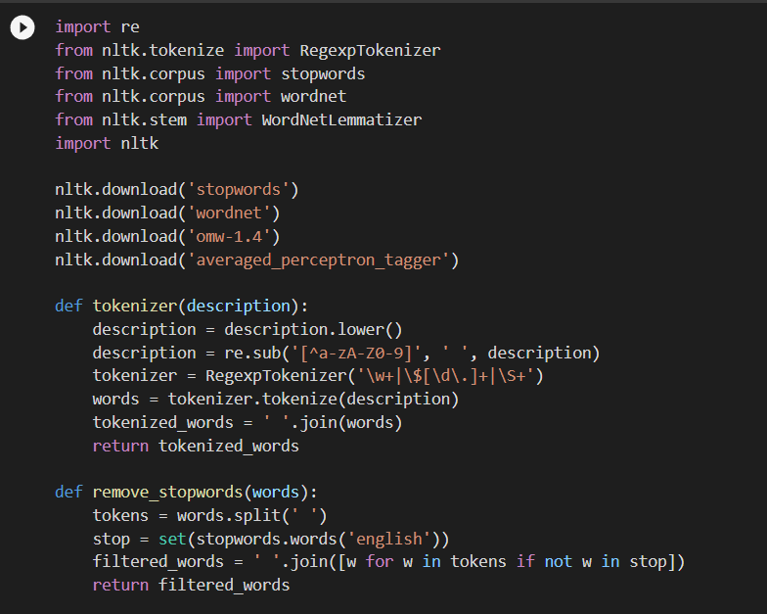
Text Preprocessing
Tokenizer(description): Tokenizes the input text by converting it to lowercase, removing any characters that are not letters or digits, and splitting the string into individual tokens or words.
remove_stopwords(words): Removes any stop words from the tokens.
25%
25%
25%
25%

Slide 21
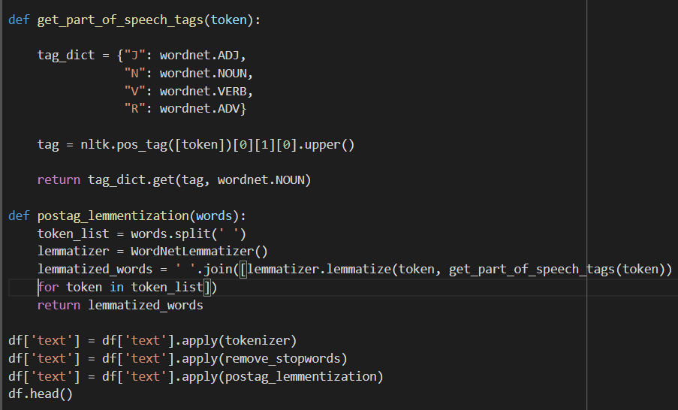
Text Preprocessing
get_part_of_speech_tags(token): Identifies the part of speech for each token in the input text using the pos_tag function from the NLTK library and returns the corresponding WordNet part-of-speech tag.
postag_lemmatization(words): Performs lemmatization on the input text using the WordNetLemmatizer from the NLTK library, using the part-of-speech tags from the get_part_of_speech_tags() function.
编辑标题
单击编辑标题
汇报：张三

Slide 22
05
Sentiment Analysis Model

Slide 23
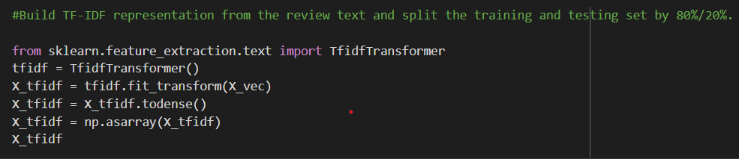
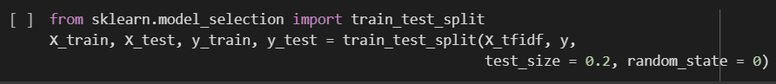
Model
Building TF-IDF representation from the review text
Splitting data into training and testing with 80/20 ratio

Slide 24
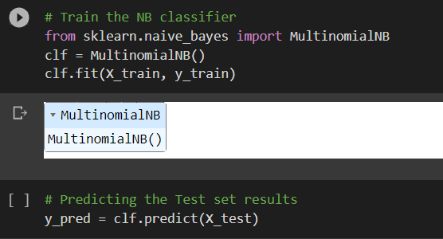
Model - Naïve Bayes
The first NLP technique we used for sentiment analysis was Naïve Bayes

Slide 25
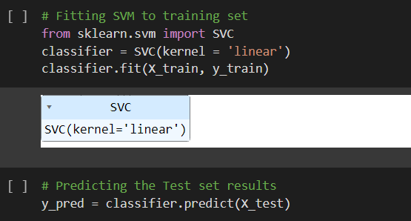
Model - SVM
The second NLP technique we used for sentiment analysis was SVM

Slide 26
06
Model Evaluation

Slide 27
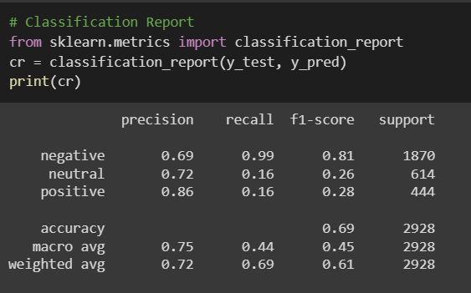
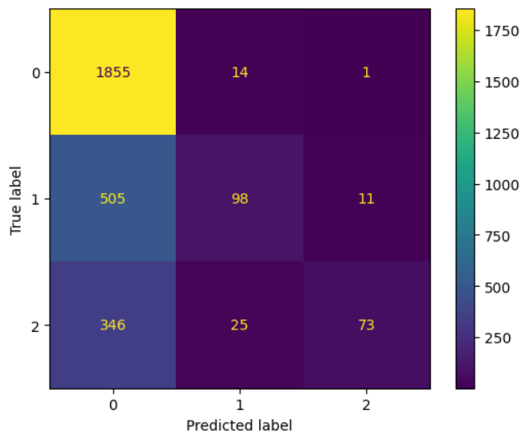
Model Evaluation - Naïve Bayes
Classification Report
Confusion Matrix

Slide 28
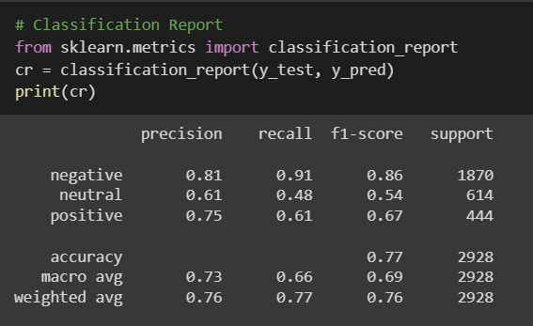
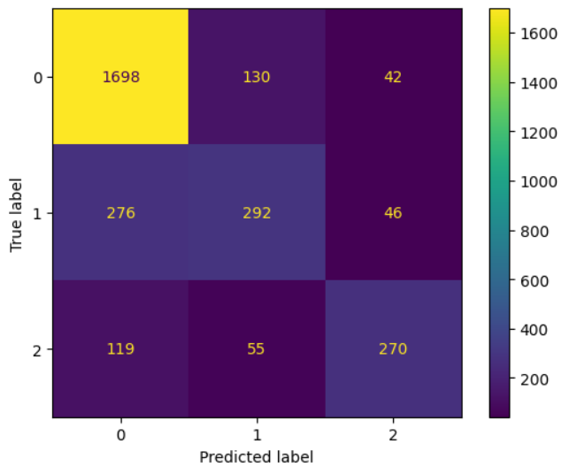
Model Evaluation - SVM
Classification Report
Confusion Matrix

Slide 29
07
Conclusion

Slide 30
Conclusion
Exploratory Data Analysis
Machine Learning Model
We can see that by far the biggest reason for negative tweets is customer service issue, and the airline with the most negative tweets is United.
The confusion matrix shows that the percentual of true positives is close in all classes, and the model is performing well for each of them.

Slide 31
08
Future Work

Slide 32
Future Work
Which percentage of airline passengers are satisfied? Does it vary by customer type? What about type of travel?
What is the customer profile for a repeating airline passenger?
Does flight distance affect customer preferences or flight patterns?
Which factors contribute to customer satisfaction the most? What about dissatisfaction?
Develop a trend analysis system to track the trends in a particular geographical location. This will help business organizations to target the right people in the right places to build their brand values.
Distance
Travel
Location
IDEA
Trend
Type

Slide 33
Thank you
Airlines Sentiment Analysis
Ashutosh Misra
Jennifer An
Nikhil Shenoy
Ning Chu
Sohaib Ahmed

